Slide 1
Interested in Becoming a
Language Assistant in England?
Apply for the TA Programme!
Seminar Slides
Goethe-University Frankfurt
Department of English and American Studies (IEAS)
TEFL Theory and Methodology

Slide 2
The Teaching Assistant Programme
For many years, the IEAS has had a successful cooperation with several public schools in various parts of England. For the next academic year 2024/25, we are looking for 6 TEFL students to become teaching assistants at these partner schools:
Badminton School, Bristol
Christ’s Hospital, Horsham
Eton College, Windsor ( Requires a student for 2 years)
Giggleswick School, North Yorkshire
Rugby School, Rugby
St. Paul’s School, London
Please note that due to Brexit a visa is
required, Giggleswick school and Eton College will organize
this directly, for the other schools an extra
application via the PAD after our interview
is required. Information about this
will be given to successful candidates.
You can find more information on the schools and your work there on our website!

Slide 3
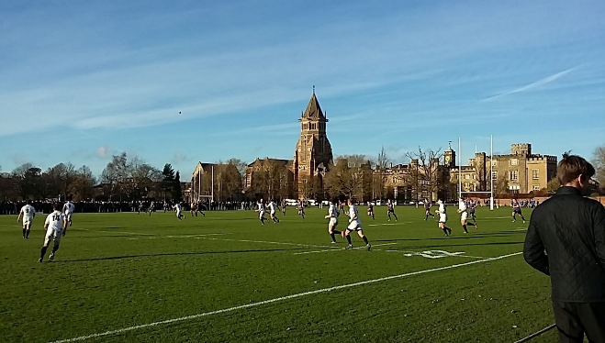

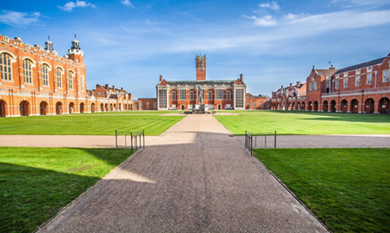
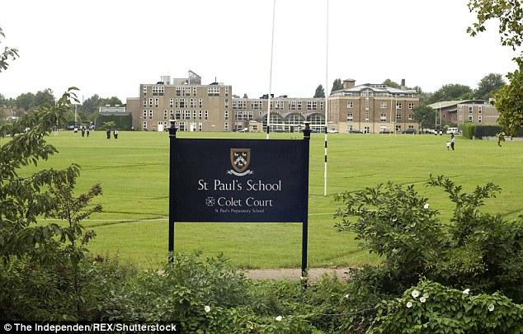
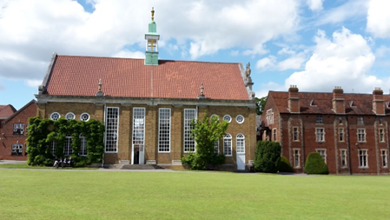
First Impressions

Slide 4

First Impressions

Slide 5
The TA Programme – Application & Important Dates
Applications can be handed in once a year until the beginning of winter semester for the next academic year. Next application deadline: November 20th 2023
Your application has to be in English (since it will be sent to the schools as well)
and has to include the following parts:
CV
Letter of Motivation
Transcript of attended courses
English Teacher (E-)Portfolio
Two academic references (at least one by a university lecturer)
You can find more information on the TA poster & flyer, which are available online, too:
https://www.uni-frankfurt.de/70126311/ContentPage_70126311

Slide 6
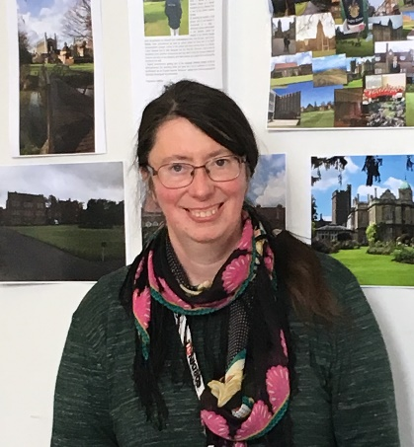
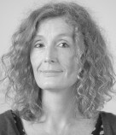
The TA Programme – Questions & Support
There will be an organisational meeting to provide an overview on the programme, expectations and the application process – and to answer any of your questions!
Zoom-Meeting: Monday 30th October at 5.30pm
Link:https://uni-frankfurt.zoom-x.de/j/61074730704?pwd=Y1IvOTBzSDRkOEJncndodHJVeGVRUT09
Ansprechpartner? Who is involved in the programme?
Mariella Veneziano-Osterrath Almut Küppers
veneziano-osterrath@em.uni-frankfurt.de a.kueppers@em.uni-frankfurt.de

